Slide 1



Project based Learning on CCTV Face Super-Resolution x2 Upscale face crops to aid identification. Hybrid: Bicubic vs FSRCNN-small
For the partial fulfillment of IA of the
Sub: Elective 1- Image Processing, B.Tech (E & Tc) Sem-VII AY 2025-26
Submitted by:
Name of Student: Ankit Kumar
Roll no:42
PRN no:2214110298
IP PBL

Slide 2

CCTV Face Super-Resolution
Enhancing Low-Resolution Face Images for Improved Identification
IP PBL

Slide 3
Project Overview
Challenge
Approach
CCTV footage often captures faces at low resolution, making identification difficult. This project develops a 2x upscaling solution to enhance face crops from surveillance feeds, improving recognition accuracy for security applications.
We compare traditional bicubic interpolation against FSRCNN-small, a compact deep learning model. The hybrid approach balances quality with computational efficiency, offering GPU acceleration when available.
IP PBL

Slide 4




Technical Architecture
Input Processing
Super-Resolution
Extract face crops from CCTV frames using OpenCV detection pipelines
Apply bicubic or FSRCNN-small model for 2x upscaling enhancement
Quality Assessment
Visualization Tool
Evaluate using PSNR, SSIM metrics and facial identity similarity scores
Side-by-side comparison interface for qualitative analysis
IP PBL

Slide 5
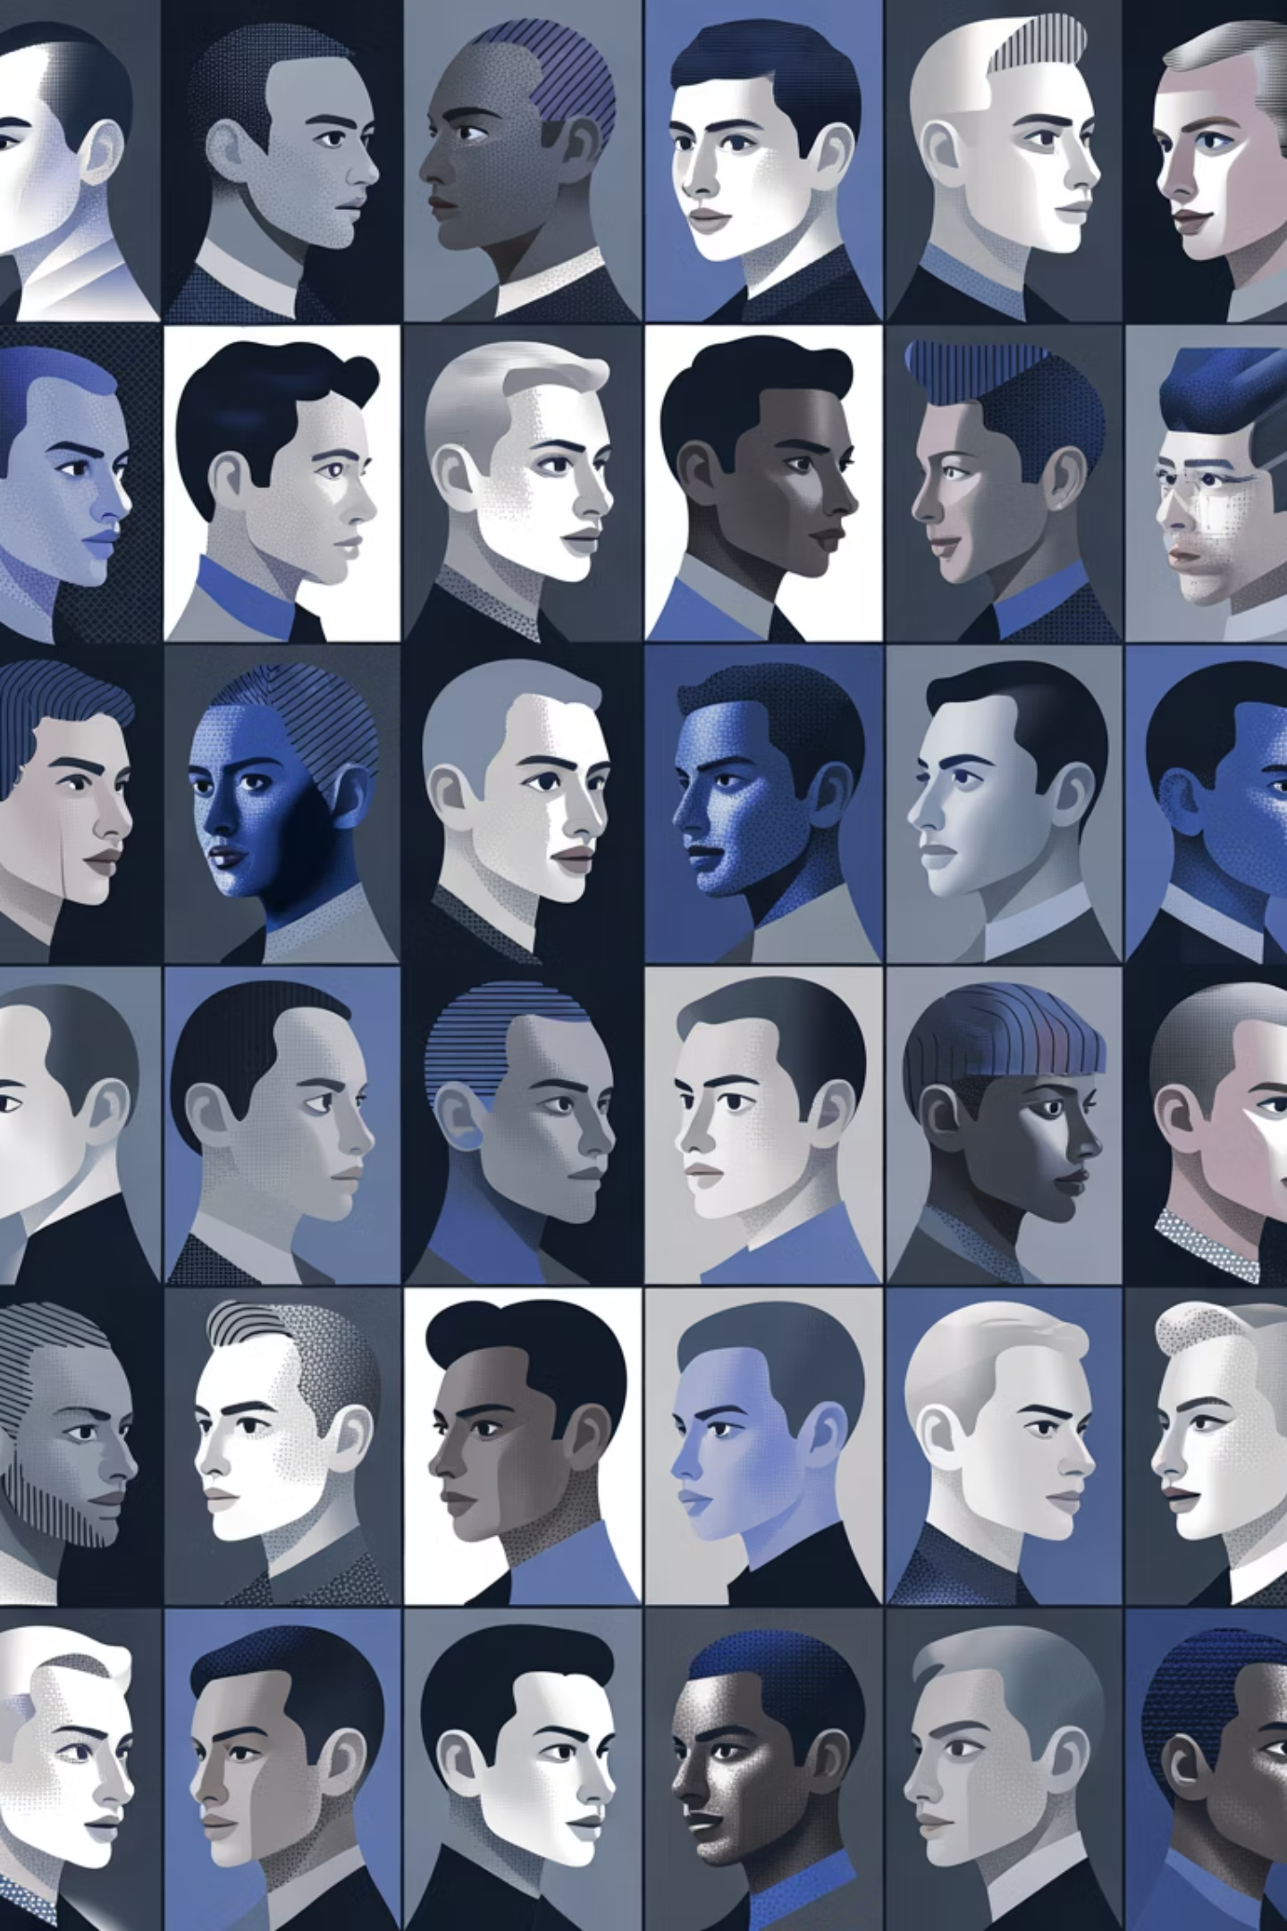
Dataset: CelebA Faces
Scale
Resolution
Source
202,000 celebrity face images providing robust training data
178×218 pixels standardized format for consistent processing
MMLAB CUHK benchmark dataset widely used in face research
IP PBL

Slide 6
Method Comparison
Bicubic Interpolation
FSRCNN-small
Advantages: Fast, no training required, CPU-friendly, predictable results
Advantages: Learned feature enhancement, superior detail reconstruction, compact architecture
Limitations: Limited detail recovery, smoothing artifacts, no learned features
Limitations: Requires training, GPU beneficial for speed, model complexity
IP PBL

Slide 7
Evaluation Metrics
1
2
3
PSNR (Peak Signal-to-Noise Ratio)
SSIM (Structural Similarity Index)
Identity Similarity
Computes facial feature matching scores to ensure upscaled faces preserve identity characteristics. Critical for identification applications.
Measures pixel-level reconstruction quality. Higher values indicate better fidelity to ground truth high-resolution images. Standard metric for image quality assessment.
Evaluates perceived visual quality by comparing luminance, contrast, and structure. Better correlates with human perception than PSNR alone.
IP PBL

Slide 8
Four-Week Development Timeline
Week 1: Data Preparation
Week 3: Evaluation
Download CelebA dataset, create low-resolution and high-resolution image pairs, implement preprocessing pipeline
Compute PSNR and SSIM metrics, measure identity similarity scores, compare bicubic vs FSRCNN performance
1
2
3
4
Week 2: FSRCNN Training
Week 4: Demo & Report
Build FSRCNN-small architecture in PyTorch, train model on prepared dataset, optimize hyperparameters
Build visualization tool with side-by-side comparisons, document findings, prepare final presentation
IP PBL

Slide 9







Technology Stack
Python Core
OpenCV
Primary language for implementation and scripting
Face detection, image processing, and visualization
PyTorch (Optional)
Deep learning framework for FSRCNN implementation
IP PBL

Slide 10
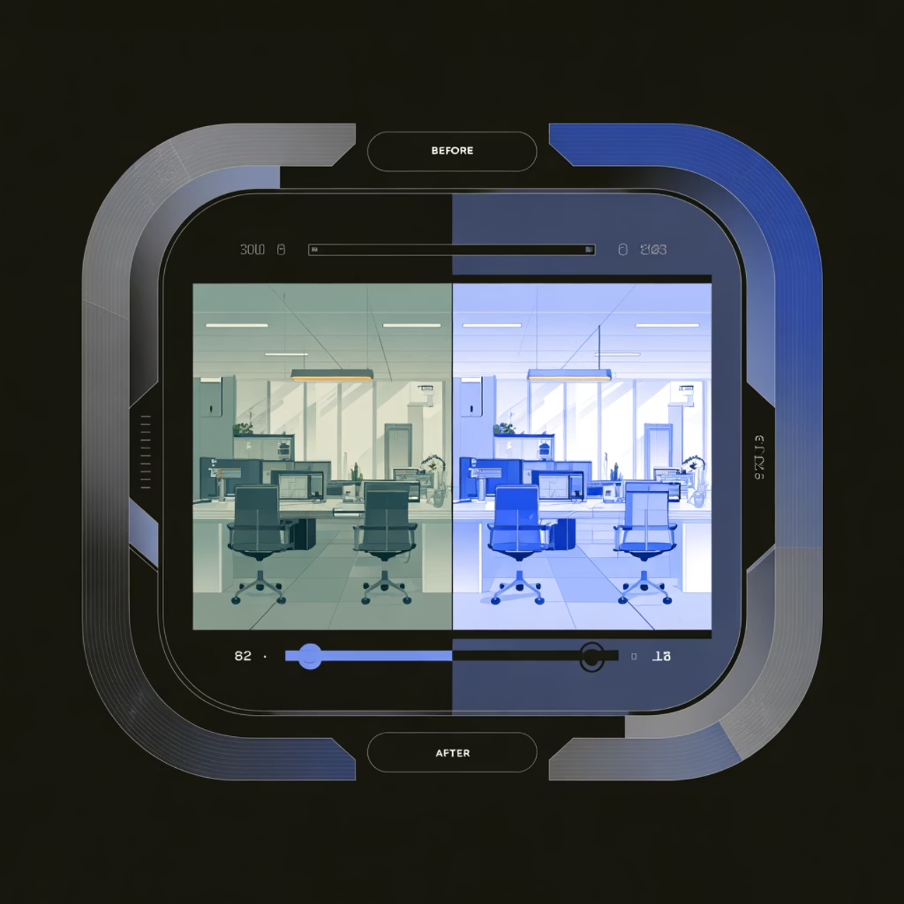
Demonstration Tool Features
Interactive Comparison Interface
Upload face crops from CCTV footage
Select enhancement method (bicubic or FSRCNN)
Generate 2x upscaled output in real-time
Side-by-side view of original and enhanced images
Display quality metrics for quantitative assessment
IP PBL

Slide 11
Expected Outcomes
2x
15-25%
95%+
Resolution Boost
Quality Improvement
Identity Preservation
Doubled image dimensions for enhanced detail visibility
Expected PSNR gain with FSRCNN over bicubic baseline
Target similarity score maintaining facial recognition accuracy
This project demonstrates practical application of super-resolution techniques for security and surveillance, providing a foundation for deploying AI-enhanced identification systems in real-world CCTV environments.
IP PBL

